Slide 1
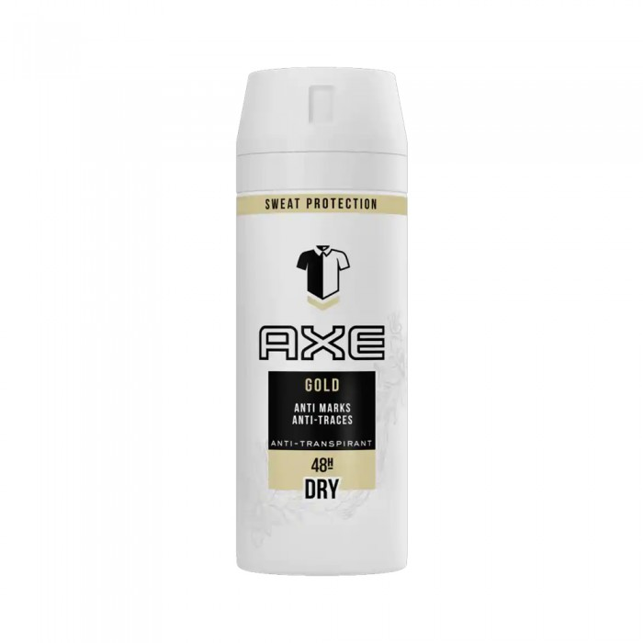
XX
X Gold Spray Deodorant 150 ml
SAR 36.80 Q
X Goldberry spray deodorant. Deodorant for men protection against tags. Men's deodorant gives you protection without white marks or yellow spots. So you can raise your hand without having to feel embarrassed again. One quick workshop under each arm in the morning and you will be refreshed and feel comfortable and confident.

Slide 2
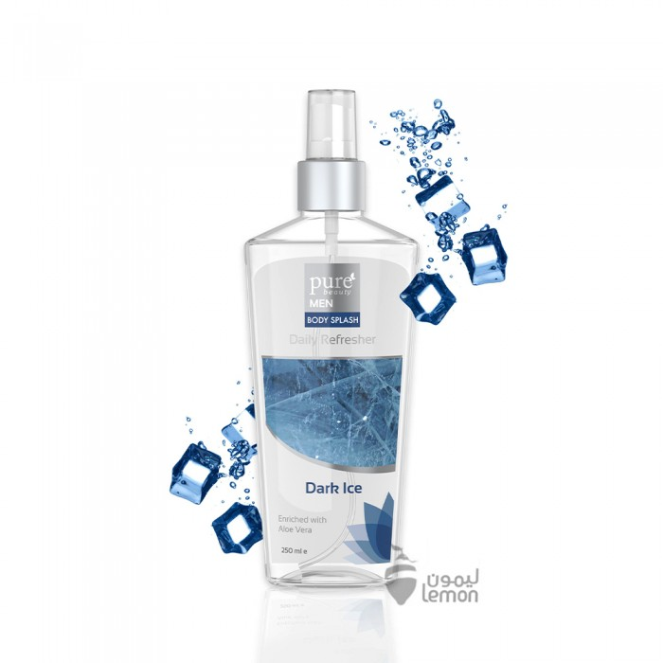
Pure Beauty
Pure Beauty Dark Ice Body Freshener 250ml
SAR 40.25 Q
Pure Beauty Dark Ice Body Freshener gives you a beautiful and durable smell all day long. Contains moisturizing and soothing aloe vera. It gives your skin a feeling of freshness.

Slide 3
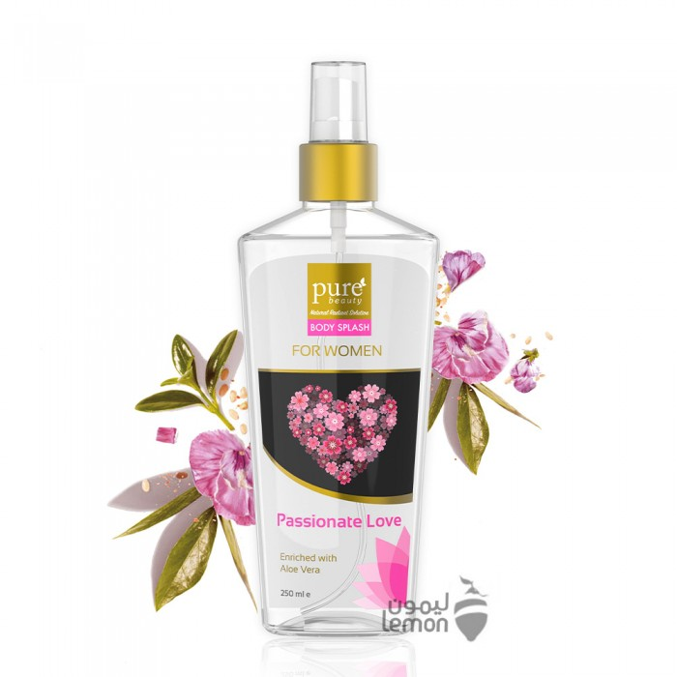
Pure Beauty
Pure Beauty Body Freshener Passion LAV 250ml
SAR 40.25 Q
Pure Beauty Body Freshener Passion Lav gives you a beautiful and durable smell all day long. Contains moisturizing and soothing aloe vera. It gives your skin a feeling of freshness.

Slide 4
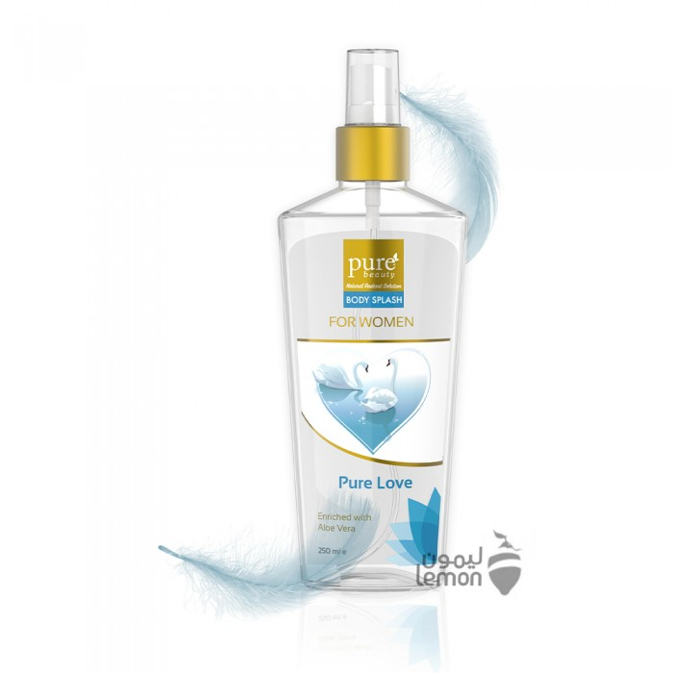
Pure Beauty
Pure Beauty Pure Love Body Freshener 250ml
SAR 40.25 Q
Pure Love Body Freshener Pure Beauty gives you a beautiful and durable smell all day long. Contains moisturizing and soothing aloe vera. It gives your skin a feeling of freshness.

Slide 5
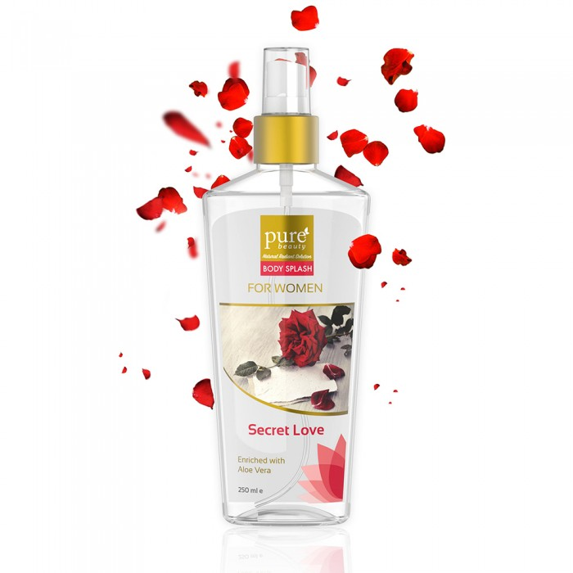
Pure Beauty
Pure Beauty Body Freshener Secret Love 250ml
SAR 40.25 Q
Pure Beauty Body Freshener Sickert Love gives you a beautiful and durable smell all day long. Contains moisturizing and soothing aloe vera. It gives your skin a feeling of freshness.

Slide 6
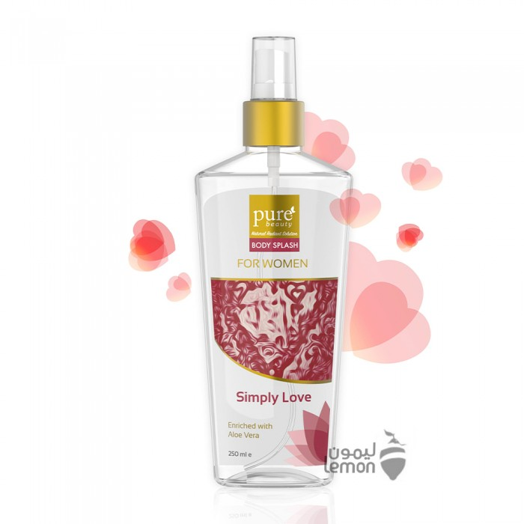
Pure Beauty
Pure Beauty Simple LAV Body Freshener 250ml
SAR 40.25 Q
Pure Beauty Simple Love Body Freshener gives you a beautiful and durable smell all day long. Contains moisturizing and soothing aloe vera. It gives your skin a feeling of freshness.

